Slide 1
Decoding-Aware Compression of FPGA Bitstream
Xiaoke Qin, Member, IEEE Chetan Murthy, and Prabhat Mishra, Senior Member, IEEE
IEEE Transactions in VLSI Systems, March 2011
Presented by:
Sidhartha Agrawal

Slide 2
Agenda
Backgrounds Info (Quickly)
Previous Work
Major Contribution by present work
  Smart Placement
  Fast decompression for VLC
  Combine RLC and bit-mask based coding
Results
Conclusion
Question

Slide 3
Code Compression Overview
Static Encoding
(Offline)
Application Program
(Binary)
Compression
Algorithm
Dynamic Decoding
(Online)
Processor
(Fetch and Execute)
Decompression
Engine
Compressed Code
(Memory)
Notes:
In a typical code compression methodology, the application program is compressed offline and placed in the memory. During execution a decompression unit is used to convert the compressed code to original instructions.
The goal of the compression algorithm is to generate the best possible compressed code without affecting the decompression performance. The decompression engine needs to be very fast to ensure that it delivers required number of instructions to the processor without introducing any stalls.

Slide 4
Decompression Engine
Barrel Shifter
Input Buffer
Decoder
Output buffer

Slide 5
Algorithm 1: Decode-Aware Bitstream Compression
Already Done
Input: Input bitstream
Output: Compression Bitstream placed in memory
Step 1 : Divide input bitstream in Fixed size symbols
Step 2 : Perform Bitmask based pattern selection
Step 3 : Perform Dictionary Selection
Step 4 : Compress symbol into code sequence using bitmask and RLE
Step 5 : Perform decode aware placement of code
Will Discuss Today

Slide 6
Run Length Encoding (RLE)
Marker
Input Stream
Without RLE
With RLE
0000 0000
0000 0000
0000 0000
0000 0000
0000 0000
0000 0000
01000010
100
100
100
100
100
100
101
100
100
100
100
100
101
11 10 00 0
Count

Slide 7
PT-n Stream
Definition: Power-Two n-bit Stream(“PT-n Stream”) is FLC stream of n-bit codes, where n is a power of two such as 2⁰ , 2¹, 2², and so on.

Slide 8
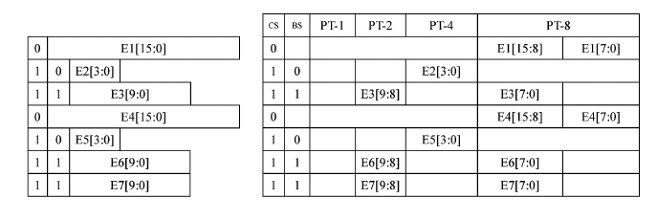
Code Placement: Step1 of 2
c

Slide 9
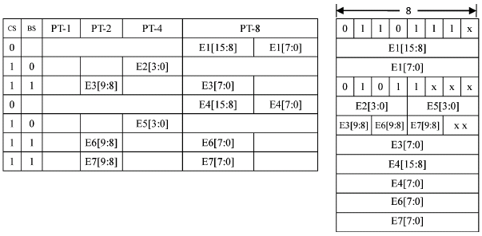
Code Placement: Step 2 of 2
c

Slide 10
Theorem
The total number of unused bits Nw is less than (log₂b + 2) * b
b is the memory bandwidth,
For b = 8
  N_{w} = 40

Slide 11
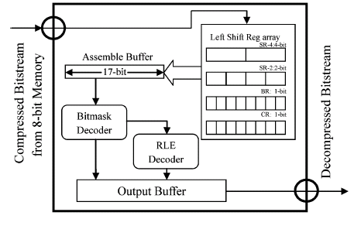
Decompression Engine (Revisited)
New

Slide 12
Overall Efficiency
Bit mask based Compression (BMC)
BMC with new dictionary selection (pBMC)
pBMC with RLE
BMC
pBMC
pBMC + RLE
~ 4%
~ 10%

Slide 13
Conclusion
Decompression Aware Code Placement
Use of RLE and BMC
Comments
  Very Comprehensive Paper(s)
Questions
  ???

